Slide 1
PSA Election Presentation
February 2023

Slide 2
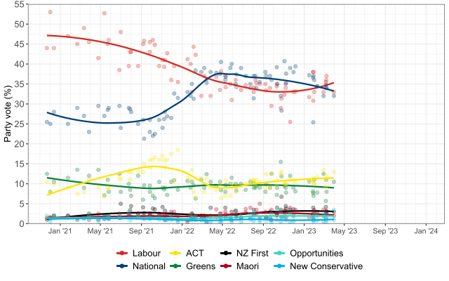
What we do matters
Notes:
Open with the fact that this election is very close – and that means what we do over the next six months matters and will help decide what sort of country we live in.

Slide 3
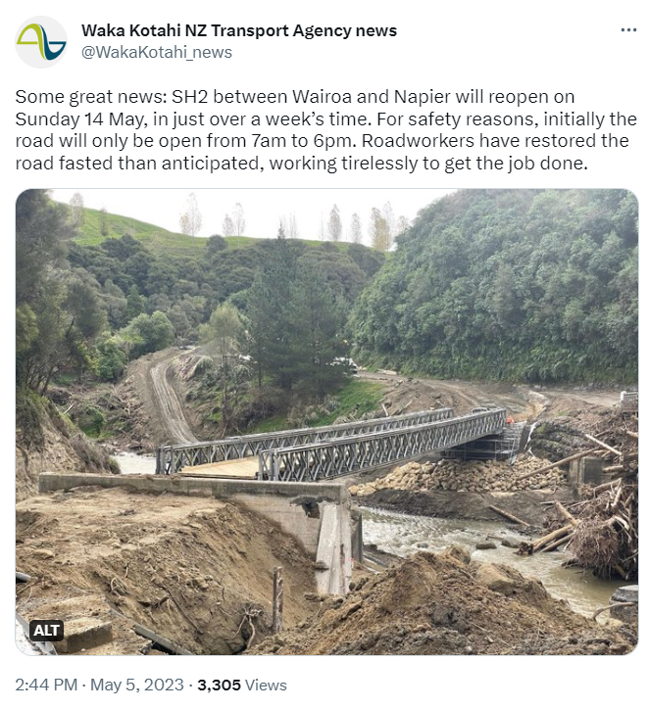
Who pays the cost of the current crises?
Notes:
These are difficult times – global events like the pandemic and the War in Ukraine have had huge economic impacts. More locally disasters have added to costs, as fruit and vegetables were lost to flooding. One of the key questions right now is how we meet the costs of the current disaster – do we meet them collectively or does the cost fall on individuals?

Slide 4
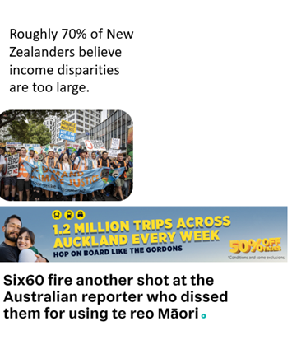
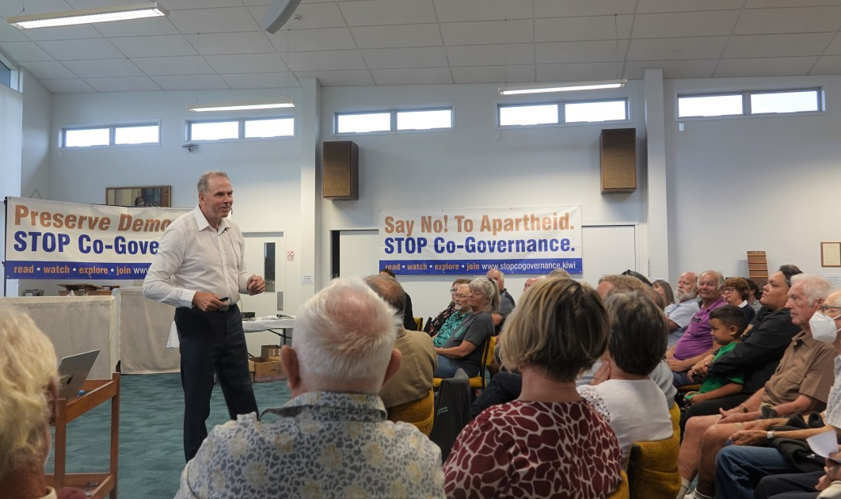
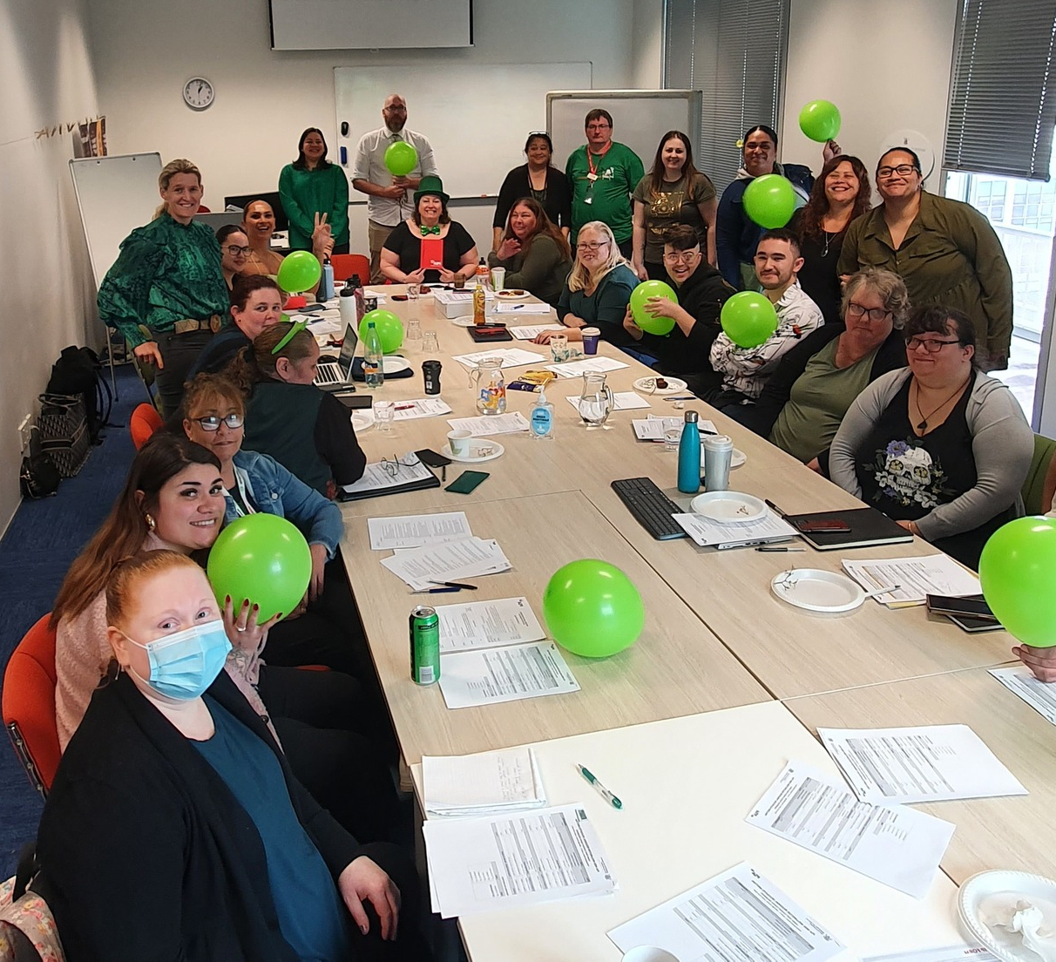
What sort of New Zealand do we want?

Slide 5
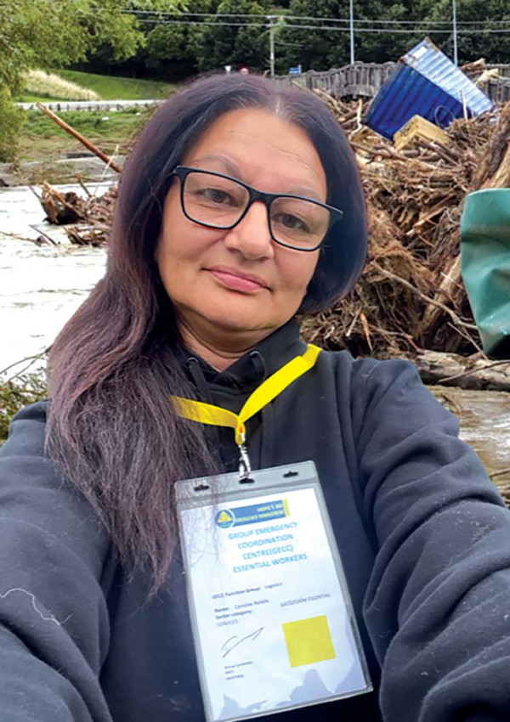
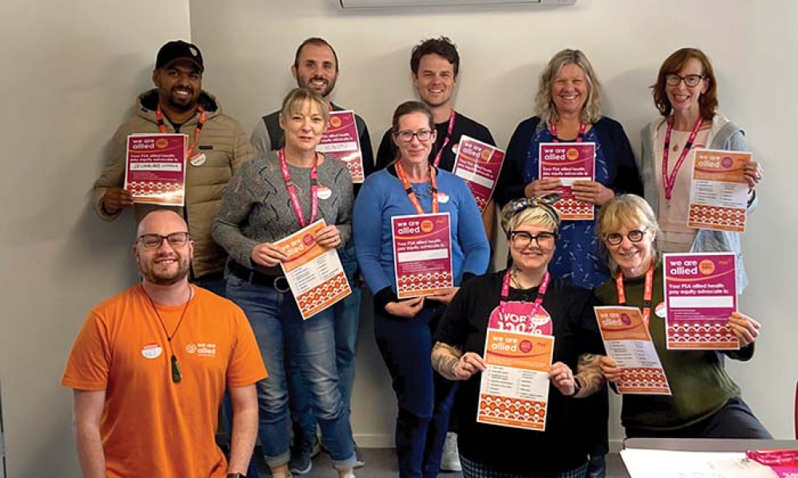
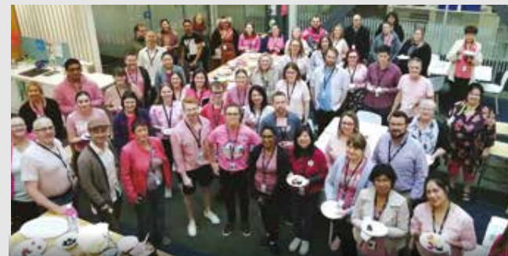
Public and community services, it’s what we all do together
Stand Together for Public and Community Services
Notes:
Workers in the Public and Community Services are necessary both to meet the costs of the current crises and also for building the society we live. Your work is essential for the sort of world we want to build. Some parties are attacking the work that we do. We believe its vital to challenge attacks on the work we do and to make protecting public and community services a key debate this election. We would like to hear from you how we can support you to have conversations at work, and with family and friends about the need to stand together to defend the work we do on behalf of all New Zealanders.

