Slide 1

Establishing Localities
A locality approach within a reformed health system
December 2021

Slide 2
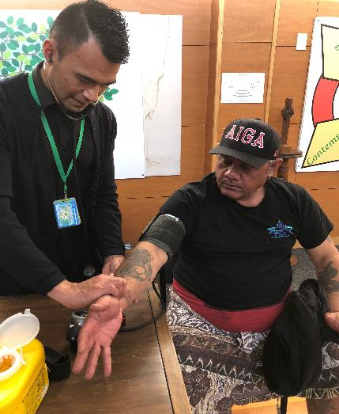

Why reform the health system?
      The vision is to build a system that achieves pae ora healthy futures for all New Zealanders
Notes:
PURPOSE: ARTICULATE THE VISION
Back in 2020, the reforms were announced with the aim of transforming the health system to achieve pae ora/healthy futures for all New Zealanders.
While the system works well for the majority of New Zealanders, we know it doesn’t work equally well for all people – this is particularly true for Māori, Pacific and disabled people.
What we also see is a highly skilled, dedicated and professional health workforce that, fundamentally, isn’t supported by the system they have to work within. It makes things way too hard.
​
In the last decade, our health system has become increasingly complex with a plethora of organisations and functions now split across national, regional and district entities – with unclear and overlapping roles at times.
This growing complexity also drives inefficiencies. ​
​
Some of you will have also heard the expression ‘post code’ lottery.​
Where you live in New Zealand should not dictate your access to good quality health services.​
​
It is not good enough for our health system to be good for many if the outcomes for others are consistently poorer due to a range of factors that we think could be addressed if we changed the way our system works.​
​
I want to briefly pop up some numbers that highlight some of the ways the system has failed these key groups. These are a reminder of why this change is so important.

Slide 3
Five key system changes we need to achieve
1
The health system will reinforce Te Tiriti principles and obligations
5
Health and care workers will be valued and well-trained for the future health system
All people will be able to access a comprehensive range of support in their local communities to help them stay well
2
Digital services will provide more people the care they need in their homes and communities
Everyone will have equal access to high quality emergency and specialist care when they need it
4
3
Notes:
PURPOSE: DESCRIBE THE ASPECTS THAT NEED TO CHANGE TO ACHIEVE OUR VISION
Under-pining these inequities is a system that has become increasingly and overly complex, and out-of-date with the ways people expect to receive health services, and under unsustainable financial pressure.
It’s also unnecessarily fragmented resulting in organisations with unclear or overlapping roles, responsibilities and boundaries. There is significant duplication of activity and effort, and variation that creates the post-code lottery for those accessing health services I’ve just mentioned.
Many of you will have your own views and reasons as to why the health system needs to change.
You are a highly skilled, dedicated and professional health workforce, but fundamentally, the system doesn’t always support you to do the best you can. It makes things way too hard.
This reform is about how we collectively make things better, together, to deliver better outcomes.
So, we’re focused on the key areas we need to change to deliver pae ora.
What the future looks like
The future health system will be characterised by five key system shifts.
The health system will reinforce Te Tiriti principles and obligations
Everyone will have access to a comprehensive range of support in their local communities
Everyone will have access to high quality emergency or specialist care when they need it
Digital services will provide more people with the care they need in their homes and communities
Health and care workers will be valued and well-trained for the future health system.
Let’s look at the structural changes that are going to enable these shifts to happen.

Slide 4
Primary and community services reorganised to serve communities through ‘localities’ with a focus on population health
Notes:
​
Every locality will have a consistent range of core services, but how these services are delivered will be based on the needs and priorities of local communities.
People will be empowered to engage in planning and commissioning of community-based care to ensure that services in each locality reflect the particular needs of their community and allows them to support themselves.
There are four pillars underpinning a population health approach:​
Whanau ora – action on the wider determinants of health (eg. housing, institutional racism, inequalities in wealth and power, a sense of purpose and belonging)
Mauri ora – supporting communities and whanau to change behaviours and lifestyles (smoking, activity, nutrition, drinking, gambling)
Wai ora – supporting communities and whanau to have sustainable places and communities to stand in (the built and natural environment), and
an integrated health and care delivery system.

Slide 5
Locality approach
Localities are geographic areas that are determined to capture as far as possible distinct communities of interest within practical boundaries that enable a strong community voice
Locality approach – communities determining how care is organised and delivered and connecting health and social care providers in response
Approximately 20k-100k population
Every locality will have a consistent range of core services, but how these services are delivered will be based on equity/the needs and priorities of local communities.

Slide 6
The organising systems
A framework for organising service delivery
  There are four organising systems that need to interface to deliver a locality approach (i.e. addressing the social determinants of health, driving a population health approach, and providing more cohesive and accessible services through integration):
P&C Provider networks | Public Health | Speciality services (vertical integration) | Social services (horizontal integration)
Provider networks are groups of community based services organised around comprehensive primary care teams that serve a locality These services are amenable to local tailoring (can be configured differently to meet the needs of a community) | Public health services delivered by HNZ Population health commissioned by HNZ/MHA and delivered across most appropriate providers National HNZ/MHA platform with localised delivery of health promotion resources, communications, campaigns and population health models of service | Primary and community services will be integrated with hospital and specialist services in line with agreed clinical pathways | Primary and community services will be more tightly integrated with social services and existing community intersectoral organisations (e.g. place based initiatives, Te Tihi) to address the social determinants of health.

Slide 7
Locality Planning
New Zealand Health Plan
Māori Health Improvement Plan
Planning approach
NATIONAL
Issues / opportunities identified inform next NZHP
  Health NZ and MHA will lead health planning approaches that will inform the commissioning process in regions and localities
  This includes health needs assessment and facilitating engagement with community leaders and service providers on health priorities for each locality
  IMPBs will engage with mana whenua on priorities for Māori health, which will be submitted to Health NZ for inclusion in locality plans
  IMPBs, HNZ and MHA sign off sub-regional locality plans, and HNZ and MHA sign off commissioning plans
Commissioning
Plan
REGIONAL
Commissioning plans approve funding for localities (detail what services will be provided and how this aligns with locality plans)
Signed off by MHA & HNZ
Informs outcomes to be achieved locally
Aggregated locality plans
SUB-REGIONAL
These are the aggregation of locality info docs into manageable sub-regional plans (~14)
Signed off by IMPBs, HNZ and MHA, and includes input on iwi priorities
LOCAL
Locality info summary
Possibly >100
Outline info about the population / priorities

Slide 8
Whānau-centred approach to care
Kaupapa Māori
comprehensive care
Wayfinders (informal supports around the whānau)
Natural supports (extended whānau)
Pacific
comprehensive care
Comprehensive care
Individual / whānau
Rural
comprehensive care
Notes:
The formal “health system” is not always the first point of contact for people when they have health needs:
Level 1: whānau self management
Whānau exercising tino rangatiratanga through self management of their health and wellbeing
Level 2: Natural supports
Those living with or near the person who have the whānau relationship and who provide day to day love and care. This is where the initial DISCOVERY of a health issue or need is likely to occur
Level 3: Wayfinders
Could be a neighbour, local worker, employer, teacher, friend who works to CONNECT the person / whānau to formal care
Level 4: Comprehensive care team
Medical care (e.g. nurse, care coordinator, mental health, doctor, physio, pharmacist) and other social supports provided to an individual or whānau within a locality. Note that there are different models of comprehensive care (kaupapa Māori, Pacific, rural etc), and more models may evolve over time

Slide 9
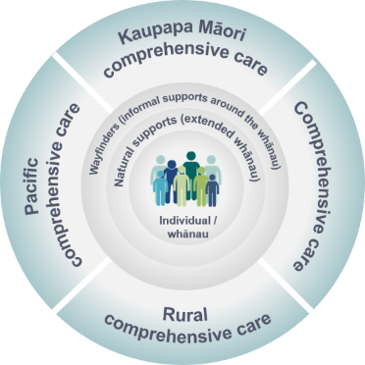
Puāwai: provider networks supporting communities to flourish
Connecting priority cohorts and comprehensive primary care
Māuiuitanga taumaha
(chronic illness and complex care)
Provider networks likely to span more than one locality
Integrated with, comprehensive primary care teams
Priority cohorts: natural groupings of services that could be clinically integrated around a model of care for specific condition types or stages of the life course.
Oranga kaumātua
(aged care / those with frailty)
Oranga hinengaro
(mental health & addiction)
Hauora tūmatanui
(public health clinical services)
Oranga rangatahi
(healthy youth)
Oranga whānau, oranga pēpi
(families and babies)
Notes:
Across the primary and community service sector there are natural groupings of services that could be clinically integrated around a model of care for specific condition types or stages of the life course. These groupings are referred to as priority cohorts.
The priority cohorts will be connected with comprehensive primary care teams in localities to form a provider network.
The NGO sector being networked with comprehensive primary care as part of the care continuum will support more comprehensive and effective models of care for whānau.

Slide 10
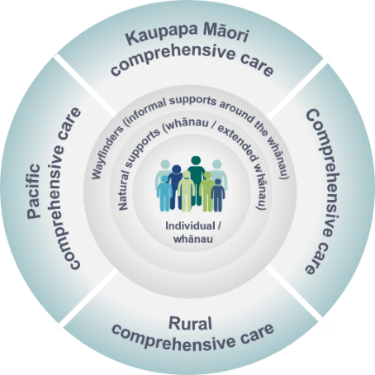
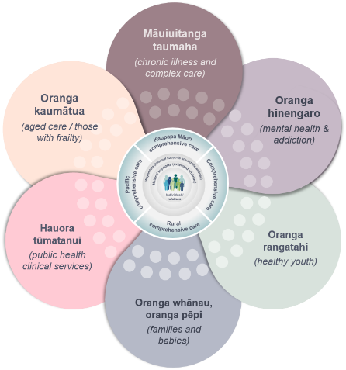
Overarching service delivery model for primary, community and population health
Population health
Puāwai: Provider networks that support localities
Comprehensive primary care teams
Priority cohorts
Action on environmental factors
Lifestyle and behavioural change
Integration
Integration
Public health services
Hospital & specialist services
Social services
Socioeconomic action
Notes:
Provider networks contracts will emphasise:
Integration with public health, specialist, and social services
Data sharing
Extended access through digital channels
Shared pathways
Shared clinical governance
Provision of impact metrics

Slide 11
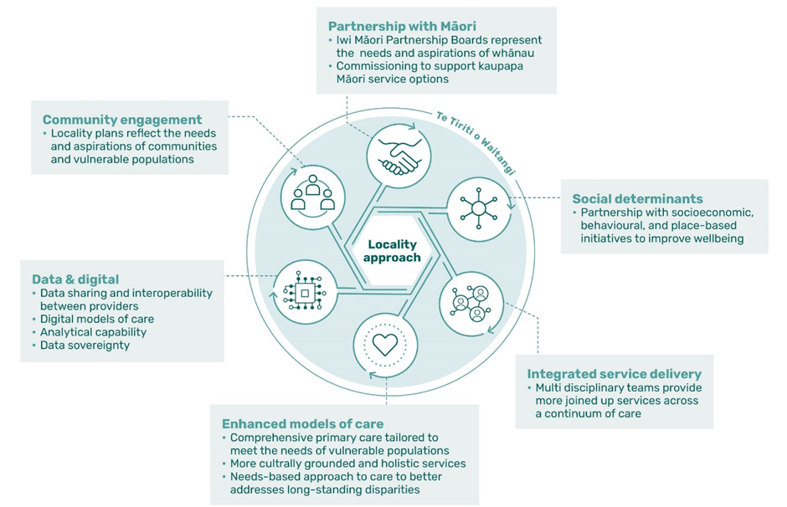
Core elements of the locality approach
There are six core elements required to operationalise a locality approach for people that reinforce the key system shifts agreed by Cabinet in March.

Slide 12
Provider network
Provider networks will provide joined up services for localities
Networks are expected to:
Honour Te Tiriti o Waitangi obligations, and ensure the viability and sustainability of kaupapa Māori service options and approaches;
Take a strong population health approach, including integration with wider social sector agencies;
Proactively address equity for Māori and Pacifika in models of care
Work collectively towards shared outcomes and objectives;
Have common service requirements, priorities, standards, reporting and monitoring processes.

Slide 13
Locality Rollout: Tranche 1 Prototypes
  At least one locality in each region
  A locality with a high Māori population
  A network that is iwi / Māori provider led
  A locality with a high Pacific population or a network led by a Pacific provider
  At least one rural prototype
  At least one prototype which is in an urban area with high levels of deprivation
  Locality prototypes should collectively cover the priority population cohorts (mental health and addictions, mothers and babies, aged care / those with frailty, and chronic illness and complex care).
These parameters have been designed to ensure the prototypes prioritise areas the opportunity to impact on health outcomes is greatest.
Notes:
Meneka

Slide 14
What are we prototyping?
Community, whānau and consumers:
  Models of community involvement in planning and commissioning;
  Models that build the capacity of whānau and communities to manage their own health and wellbeing; and
  Digital models of care that bring care closer to home.
Locality commissioning:
  Planning and commissioning for localities that incentivises partnerships and shared accountability for outcome delivery
  Taking a population health approach, working in partnership with IMPBs;
  Connected health services with social service providers to create inter-sectoral responses to issues with a common goal of improving community wellbeing; and
  Broader community development in collaboration with local iwi, local authorities, community institutions, and NGOs to address the broader socioeconomic determinants of health (e.g. housing or youth employment initiatives).
Provider networks:
  Innovative models of care connecting comprehensive primary care teams, public health and priority cohort services (puawai); and
  Information sharing and interoperability between providers.

Slide 15
Overview of the Localities process
July – October 2021: Understanding the lay of the land
Information gathering from sector and iwi
Stakeholder engagement and due diligence
Develop objectives, parameters, criteria to determine areas of interest
November 2021 – March 2022: prototype confirmation
Working with areas of interest to develop prototype proposals
Selection of prototypes
Develop national locality learning system
March 2022 – July 2024: Locality rollout
Prototypes formally established
Phased roll out of localities

Slide 16
Discussion

