Slide 1
PAY EQUITY
ALLIED, PUBLIC HEALTH, SCIENTIFIC AND TECHNICAL

Slide 2
Contents
Pay Equity – a definition.
Why do we have pay inequities?
How does Pay Equity differ from other concepts?
Understanding value.
The Pay Equity process – the legislation and the claim.
Understanding comparators.
Other stuff you should know
Understanding the impact.
What can you do?
Find out more.

Slide 3
What is Pay Equity?
Pay equity is about women and men receiving the same pay for doing jobs that are different, but of equal value. That is, jobs that require similar levels of skills, responsibility, and effort
Understanding value is central to understanding Pay Equity. We will go into this in more detail soon.

Slide 4
Why do we have pay inequities?
The problem:
Unconscious bias/social and historical bias.
Occupational segregation.
Vertical segregation
Patterns of participation
Many health roles considered “women’s work”.
Workers of any gender in the APHST professions are included in the claim, as the pay rates for all workers are tainted by historic gendered views of your work.
Notes:
Why might the work be undervalued? Lots of reasons…! Like any social, cultural or historical factors, such as any impact of volunteer or charitable history associated with the work or if the work is considered to be “women’s work”. The work might re skills or qualities that have been associated with women and not needing payment, like if the work is seen as an extension to women's work in the home and to their traditional caring type roles. There are many other factors that could also lead to undervaluing the work on the basis of sex.
Unconscious bias/discrimination- stereotypical views about gender can negatively influence decisions about recruitment and career progression. This leads to women often being offered lower starting rates than men in many jobs and then are not promoted through salary bands as quickly as male workers
Occupational segregation- female-dominated occupations (such as nursing, healthcare, retail) tend to be paid less than male-dominated occupations (such as technology, engineering, and construction). Think about that traditional 'women's work' (e.g. caring roles). And despite a similar level of skill, knowledge and effort they are paid less than workers in male dominated occupations.
Vertical segregation- men are more likely to hold senior, better-paid positions than women, even in some female-dominated industries.
Patterns of participation- women spend a greater proportion of their time on unpaid and caring work than men and are more likely to be the primary caregivers. Women are also more likely to work part-time, often due to family commitments. Part-time work tends to pay less per hour than full-time work. This means they are more likely to take time out of the workforce and more likely to re-enter at lower salaries. They are less likely to have career opportunities while taking fulfilling caring responsibilities.

Slide 5
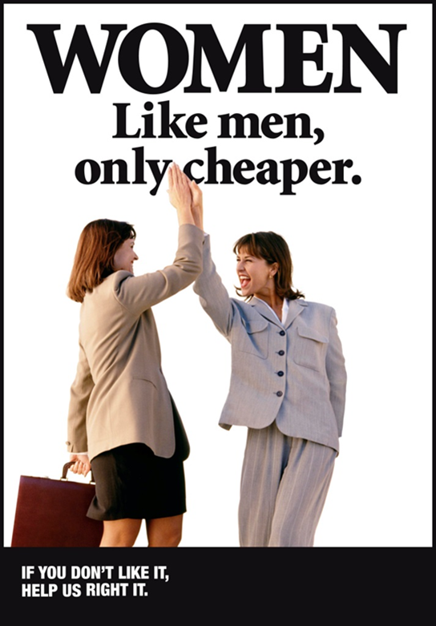
Other common terms
Equal pay/pay parity.
Gender pay gap
Ethnic pay gap.
Equal employment opportunities.
Pay Equity is the only concept that measures the value of your work. Pay Equity can help address all of these issues.
Notes:
Equal pay/Pay Parity- The same pay for the same/similar work across different employers,
organisations and workplaces. For example you are a head chef at one restaurant, and get paid the same as a head chef at a different restaurant.
Gender pay gap- Measures the difference between the average earnings of women and men in the workforce and establishes women’s position in the economy in comparison to men.
Ethnic pay gap- A measure of the percentage difference between the average earnings for everyone in a specific ethnic group and the average hourly earnings of Pākehā employees. As an example, in 2021, the pay gap between Pākehā men and Pacific women in the public sector was 27 per cent.
Equal employment opportunity- Means that everyone can have equal access to employment opportunities based on merit, without fear of discrimination or harassment. A lot of this has to do with unconscious bias.

Slide 6
What is Pay Equity?
What is “value”?
Nature of the work.
Level of responsibility.
Other risk.
Output
Academic qualifications.
Experiential/non-academic expertise.
Cultural knowledge.
Physical impact.
Mental impact.
Working conditions.
Work environment.
And more…
These elements will be captured in your role profile and assigned a score during assessment to determine the value of your work.
Notes:
There are many things that make up the value of your work, and often we haven’t taken them into account. The pay equity process which we will talk about shortly gives us a tool that allows us to measure the proper value of jobs. Think about things like people skills and emotional intelligence, are they properly valued? How have we measured them?
Stop thinking about your work just based on your duties and qualifications. Through the Pay Equity process it will be based on so much more. This is a paradigm shift in how we think about remuneration, and it is going to have a big impact on the way your pay is structured. We will talk about this soon.

Slide 7
The Pay Equity process
Legislation – the Equal Pay Amendment Act 2000
Amended Equal Pay Act 1972.
Establishes proper process to resolve pay inequities.
Requires by law that all employees under coverage of a Pay Equity claim must be included. This means:
APEX is a co-party to the claim.
Non union members are covered by the claim. (But we will be talking to them about joining up).
The PSA raised the claim. With 11,000 APHST members we are the biggest player in the game.
Notes:
The Equal Pay Act 1972 (the Act), was amended by the Equal Pay Amendment Act 2020.
The Act sets out a process for employees, unions and employers to resolve pay inequity issues.
The Act also requires that all employees in the occupation are covered by the claim. This means that the PSA has been joined by APEX as a co-sponsor of the claim, and that people who aren’t members of any union are also covered.
It is really important that we talk to non-union members about why it’s important that they join up with the PSA. They might think that they are going to benefit from the claim anyway, but actually we know that the more members we have, the more powerful we are. That gives us the ability to deliver a better outcome for everyone, and sooner. Plus, joining up with the PSA gives them access to heaps of other benefits, like being included in future rounds of collective bargaining (and any PSA member only benefits).

Slide 8
The Pay Equity process
Step 1: Raise claim | Step 2: Assessment | Step 3: Negotiation | Step 4: Maintenance
Union raises the claim. Employer assesses claim. Employer agrees arguability. Bargaining process agreement established. Completed for APHST claim | Conduct interviews and questionnaires of members. Reference group and validators create and review role profile. Role profiles scored using HEJE tool. Role profiles assessed against appropriate comparators. Establish extent of undervaluation. Process underway for APHST claim (Nov 22). | Negotiate Pay Equity rates and pay structures (e.g. pay spines). Potential phasing/staging arrangements considered. Money approved by cabinet. Offer brought to members for ratification. If offer passes – implement new pay rates and pay structures. | Negotiate mechanisms to review and maintain equal pay rates over time.
Notes:
The first step is raising a claim.
An employee or union raises a pay equity claim directly with an employer.
The claim is raised and then arguability is agreed. To be arguable the claim must cover work that is or has been predominantly performed by female employees who make up, or have made up, approximately 60 percent or more of the workforce and that the work is currently undervalued or has historically been undervalued.
Under the Act, work is not limited to an occupation within a single employer when deciding whether a claim is arguable.
When arguability is agreed the parties negotiate the process for settling the claim before moving on to the next step. If arguablity is not agreed then the claimant must decide whether or not to challenge the decision.
In your case it has been agreed!
Second step- assessing the claim.
This is where your claim is at right now and it is a big, chunky step because you have so many occupations covered by this claim.
Firstly interviews and questionnaires with different groups are carried out to make Role Profiles. These Role Profiles are scored using Pay Equity tools to determine skills, responsibilities, conditions of work, and effort needed for the role.
The Act then requires an assessment of the work of appropriate comparators to establish if the work is of equal value. We will talk more about comparators in a few slides.
When comparators are agreed and the assessment work completed the next step is to analyse and compare the information on the remuneration of the claimant and comparators in a structured way.
This allows us to establish the extent of undervaluation.
Negotiating a settlement is the third step
If the assessment has found there is gender-based undervaluation, the parties negotiate a settlement. This would include actual increases but could also include how individuals will be transferred on to new rates, and how it will be maintained going forward.
The proposed settlement is shared with all employees covered by the claim, unless they have opted out of the claim, who then vote on whether to accept the settlement. If this happens, then the settlement is implemented, and the new rates of pay offered to all people covered by the claim.
And finally, maintaining the claim
The legislation requires your employer and the PSA to agree how to make sure undervaluation does not occur again in the future. This will be part of the negotiations and will ensure we maintain pay equity going forward.

Slide 9
The impact.
Almost everyone will get a pay increase. Not everyone will get the same pay increase.
APHST pay relativities could be completely busted.
Stop thinking about just your duties and qualifications. Think about your value.
Notes:
Almost everyone will receive a pay increase. However, it is also likely that different occupations will get different pay increases.
This is because Pay Equity is not about negotiating the same increase for everyone (eg. everyone gets 5%, everyone gets $5700). It is about understanding and correcting the level of historical undervaluation of your role. It is likely that the level of undervaluation is not uniform across every occupation, and therefore the increases will differ across occupations.
This also has the potential to significant disrupt pay relativities. For instance, if you have historically been paid the same as another occupation, or you have always been paid a certain percentage more or less than another occupation - this might not look the same after settlement. This is because these historical relativities may also have been incorrect when it comes to the value of your work.
This represents a paradigm shift in you look at how your pay is measured. This will be a challenging concept for a lot of people and could also produce some really surprising outcomes. It’s really important that you engage with your PSA Allied Pay Equity Advocate to ensure you understand this process

Slide 10
Comparators
Someone doing work of similar value (not necessarily duties) but in a male dominated occupation.
Comparators for the PSA DHB Admin/Clerical claim:
Customs Officers.
Fisheries Officers.
Mechanical Engineers.
We get to save some time by using comparators from other claims (if appropriate).
Comparators in the APHST claim will be confidential until ratification.
Notes:
A comparator is a person who is doing work that may be of a similar value but in a role that is mostly performed by men. It is not just about similar duties – we are making comparisons based on the value of the role, which means it is based on all the things we looked at a few slides back. This can have some unexpected outcomes. For instance, a comparator for DHB Admin workers was mechanical engineers!
We look at what skills, demands and responsibilities are needed for the comparator roles and look at their working conditions to establish if the work is comparable.
This sounds all so simple and straightforward right? It’s not, and it is a big piece of work. We also have to get male comparators to agree to be interviewed and assessed to build up a library of profiles we can use.
Upon the request of the employers of these male dominated occupations, the PSA and government has agreed not to release the details of comparator roles until we bring the claim out for ratification.

Slide 11
Other things you should know.
We cannot strike.
Employment Relations Act 2000 vs. Equal Pay Amendment Act 2020.
What can we do to show our power instead?
Pay Equity is more rooted in co-operation than MECA bargaining. Unions and Govt have agreed that this has to be resolved, and are working together to resolve it.
There could still be some disagreement – so we need to be ready.
Notes:
Pay Equity is governed by a different piece of legislation (Equal Pay Act 1972) to MECA bargaining (Employment Relations Act 2000). The Equal Pay Act 1972 does not contain any provisions for industrial action.
This means that if we do have a dispute over Pay Equity (this is not a given), we need to think about how to demonstrate our collective power without industrial action.
We want to know what you think is the best way to do this in your individual workplaces. If you have ideas, please contact your local Allied Pay Equity Advocate!

Slide 12
Our campaign.
The most important goal is education.
If something goes wrong, we have to be ready to show our power.
You are in control. Tell us what you need, and how we can support you to do it.
PSA merch: www.sigpromo.wip.co.nz/psa
Notes:
Pay Equity is a complicated concept that involves some big changes. The biggest challenge for us is to make sure that members fully understand the process before they cast their vote.
Everything that we do needs to be an opportunity for education – so all campaign activities are going to be based around educating you on the claim, the process and the potential outcomes.
However, we also need to make sure that we are continuing to build and maintain momentum from the We Are Allied campaign, in case we do need to take action. We have to be ready.
This campaign is being led by members. We have over 70 different professions in hundreds of workplaces around the country, and we will all need different resources to make sure we understand Pay Equity. Our PSA officials need us to be communicating with them on exactly what we need, so they can support us to deliver it.

Slide 13
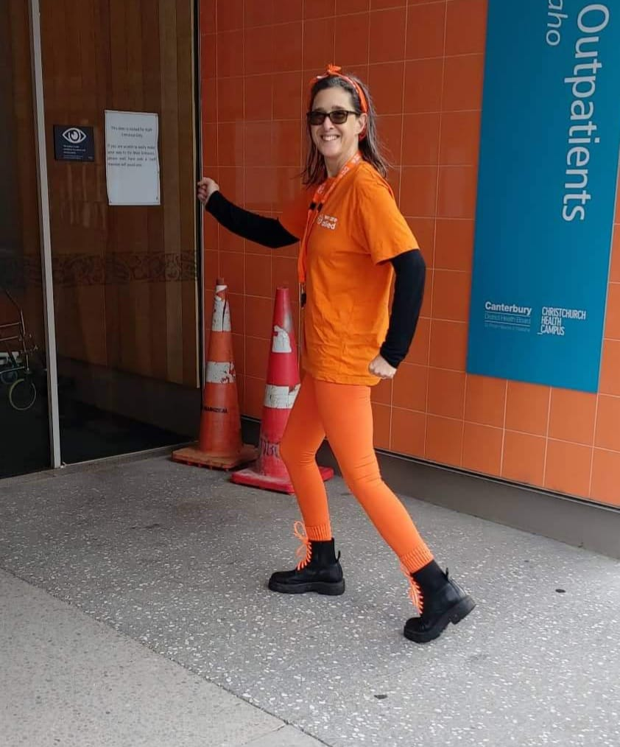
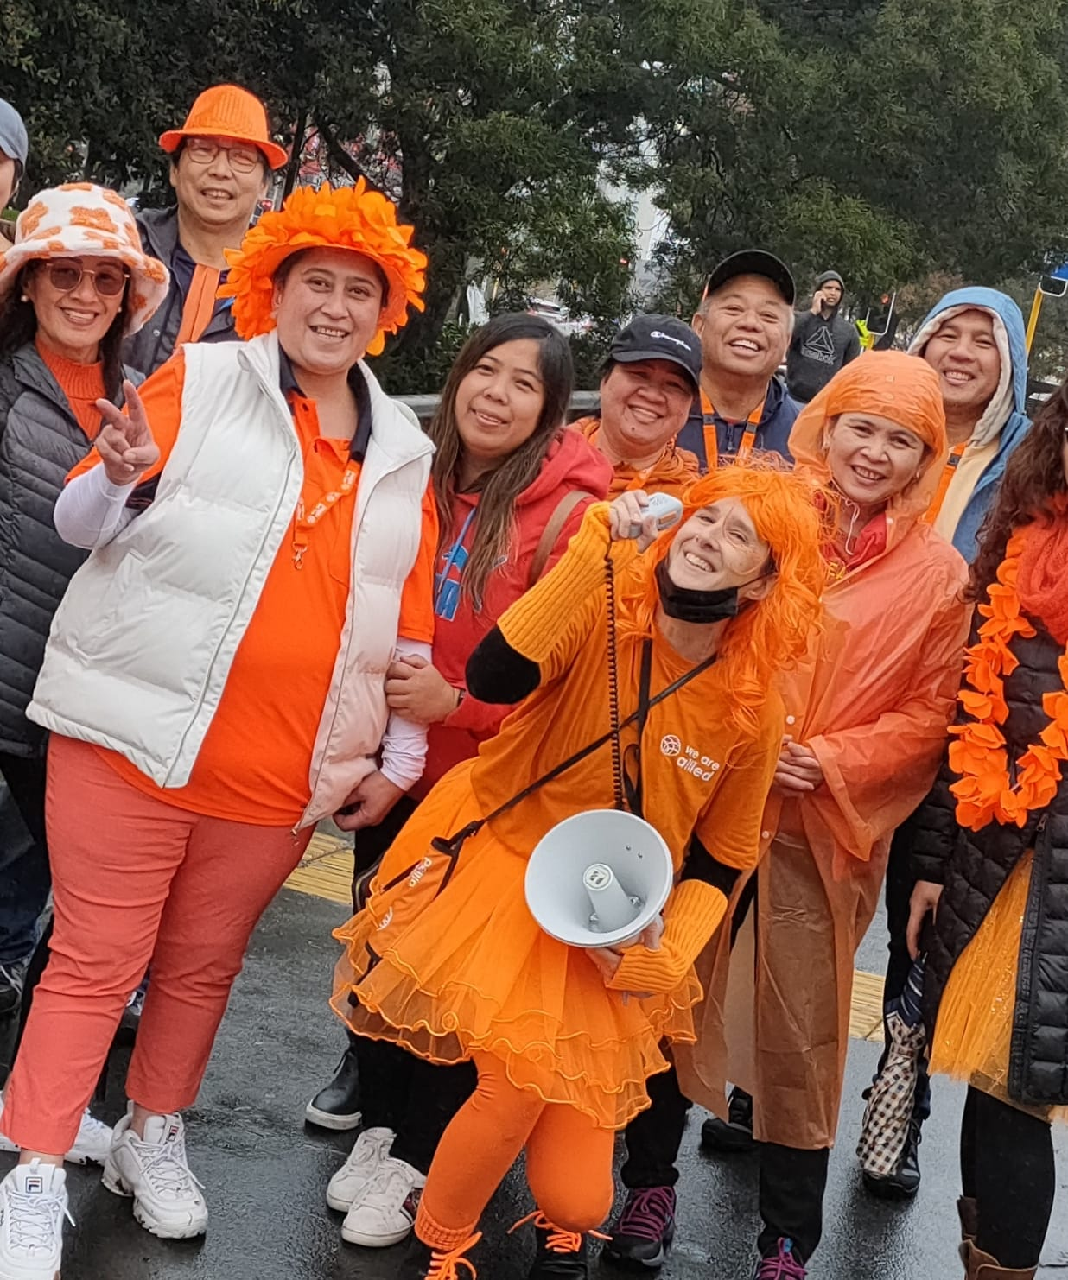
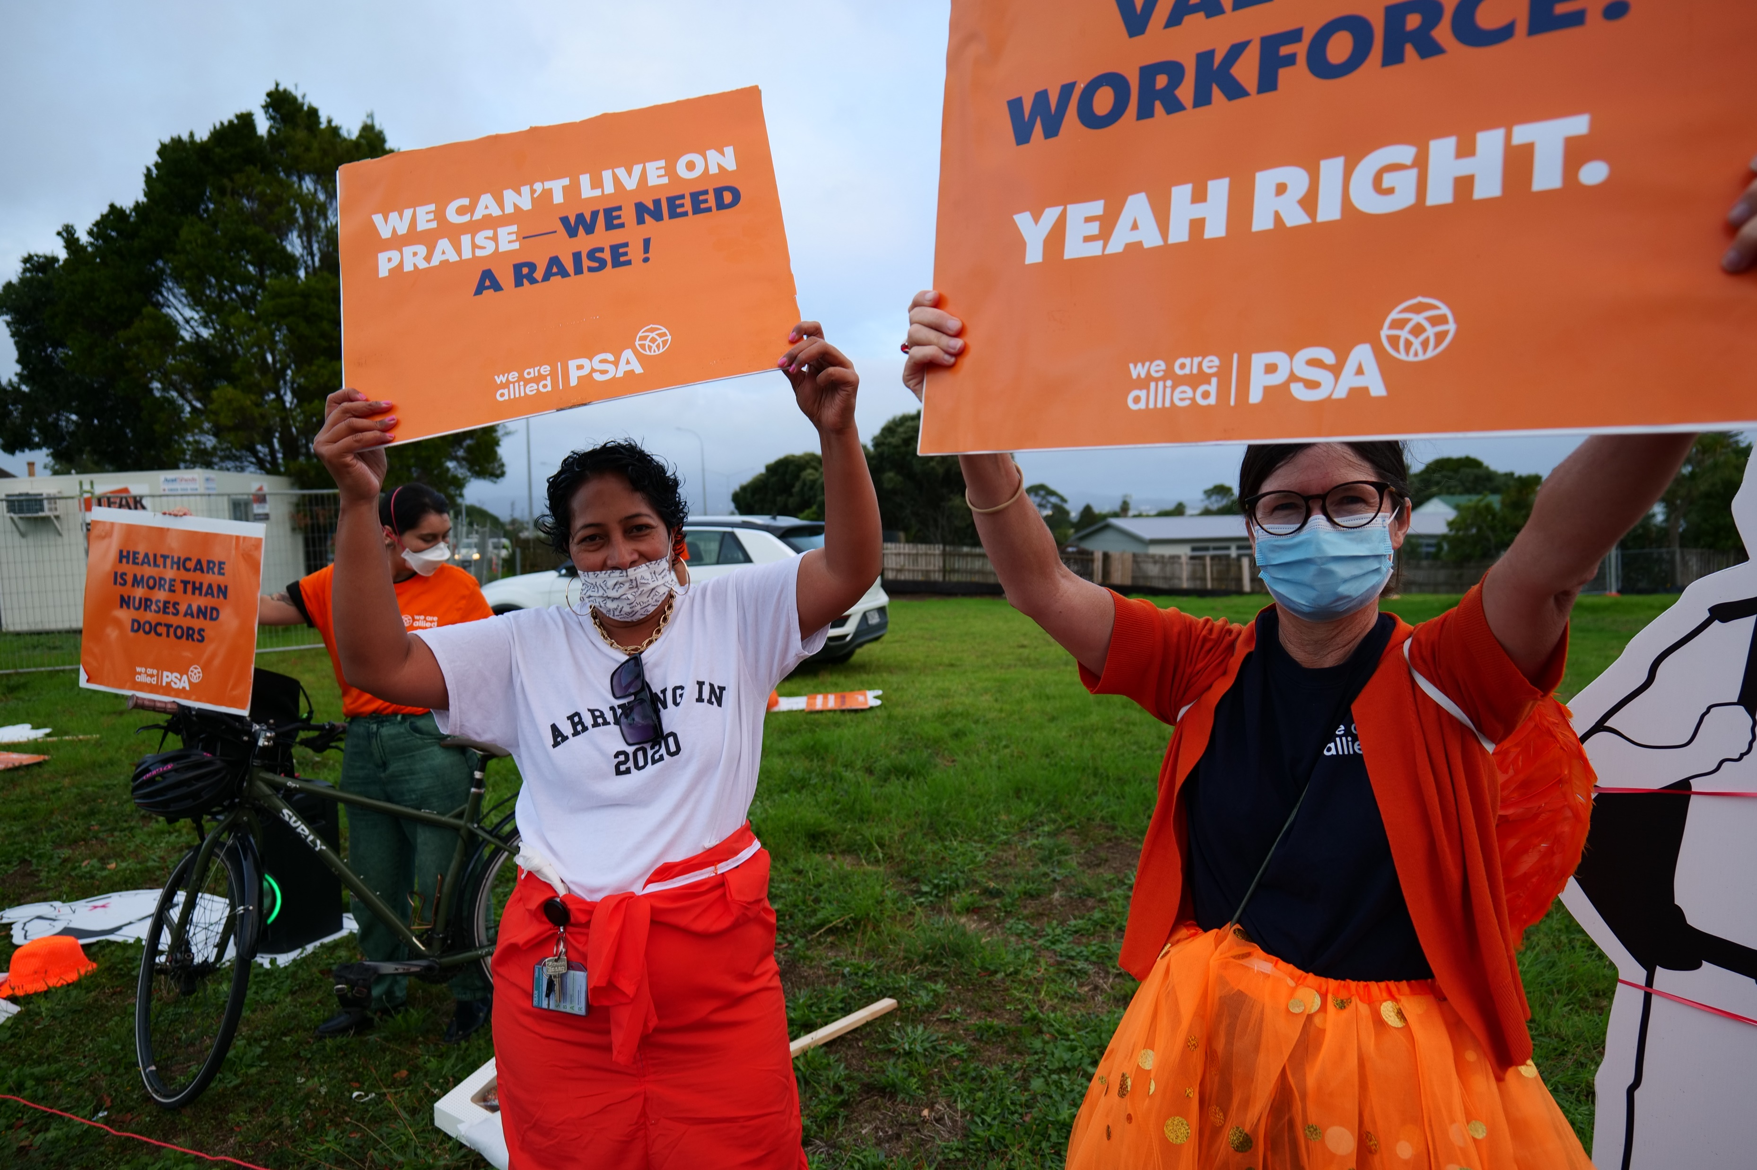
ORANGE AND PINK FRIDAYS!
GET YOUR WHOLE WORKPLACE INVOLVED!
Put up posters, signs and decorations!
Wear orange and pink (PSA merch or source your own)!
Shared morning teas/lunches!
Take photos and post on social media!
Sign waving before/after work or at lunch!
What do you want to do? Get creative, and let us know how we can help!
Make sure that there are not barriers to participation. Getting involved should be easy.
Notes:
Orange Fridays were the backbone of our last campaign, and they will be continuing into the Pay Equity campaign in the form of Orange and Pink Fridays!
These can look different for every workplace, depending on our needs. It doesn’t even have to be on Fridays!
Any action that we take should be sustainable – e.g. it should be easy for us to participate in, and shouldn’t require too much effort. Everything we do should also be an opportunity for education.
What can we do locally?

Slide 14
How to find out more:
www.psa.org.nz/allied - your one stop shop for information.
Progress updates.
FAQs.
Find your local Pay Equity Advocate.
Posters, resources and activities.
Fortnightly emails.
Campaign activities.

Slide 15
THIS IS HISTORIC
Together we are going to end over 100 years of gender based pay inequity.
Get excited.

