Slide 1
Experiences of Digital Technology for Home Support Workers The need for a human centred approach
Leon SalteR, Lisa vonk & ANDREA FROMM
Notes:
Add PSA logo??

Slide 2
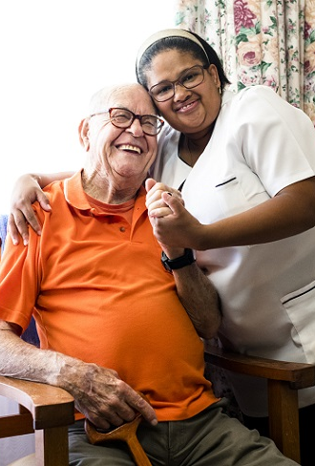
What are Home Support Workers (HSW)?
In-home personal support (cleaning, meals, washing, administering medication etc.)
Care for vulnerable groups (older people, people with disabilities)
HSW workforce = mostly women, aging, proportionally high migrant worker
Poorly renumerated work

Slide 3
The systemic context
Publicly funded but privately delivered
Mix of for-profit and non-profit providers
Funding linked to individual clients
Notes:
Home care in New Zealand is predominantly publicly funded, but predominantly delivered privately through a mix of for profit and non-profit providers.
The clients that home support workers provide care to generally have individualized funding for a set of particular tasks
Care providers deliver this care through tender system from funding bodies Ministry of Health & ACC
Overly complex, fractured & inefficient system which is very difficult for HSWs and unions to navigate

Slide 4
Rationalisation
Market dynamics shape home care
Centralisation of staff and management structures
Use of technology for efficiency gains
Notes:
This context means that market dynamics shape the way that care is delivered.
There is an incentive for these providers to run ‘efficient’ operations by reducing pay and other costs
Centralisation of staff and management structures (local offices and coordinators often replaced by low-paid regional coordinators in call-centres
Real challenges in this context for HSWs – they are often isolated and have had to fight really hard for even the most basic pay and entitlements.
Technology in this context becomes associated with efficiency gains

Slide 5
HSWs and digital technologies
Increasing use of apps to regulate workflow & allocate clients to HSWs
Sold as empowering to clients & making HSWs work easier
Notes:
HSWs are now often expected to use a smart phone, it is integral to their work.
Text messaging and email are important means for communication for care providers and HSWs
One of the core technological infrastructures that HSWs have access to are Digital platforms or apps designed to fill gap where there are no longer human managers and local offices
Main app functions: roster, client/task information, timesheeting & GPS tracking (not yet full Uber for care as in other countries)
Sold as empowering to clients & making HSWs work easier

Slide 6
Platform-isation
Platform technologies are digital infrastructures which mediate two or more groups (Srnicek, 2017)
Large, multinational technology companies involved closely in developing these infrastructures with governments and private providers
Platform technologies are not neutral but interwoven with economic, social and political processes
Overseas: development of uber-for-care apps
Notes:
The increasing technologization of care workforce can be descrbied as platformisation.
Platform technologies are digital infrastructures which mediate two or more groups
Large, multinational technology companies involved closely in developing these infrastructures with governments and private providers
Platform technologies are not neutral but interwoven with economic, social and political processes – the neoliberal, rationalized context of care shapes what providers imagine technology can do, how it is deployed, and how they are used by workers.
Despite ‘tinder for care’ Uber-style platforms not making inroads, these apps can impact working conditions
Platformisation then captures the broad trend towards the adoption of platform practices in diverse sectors and workplaces, including those traditionally characterised as relatively secure and well unionised like the home care sector

Slide 7
Platformisation and HSWs
International research suggests way digital and platform technologies have been adopted not been beneficial to workers
Nonetheless, workers and unions not fundamentally opposed to technology - if a technology is managed and governed well it has the potential to improve working conditions and the quality of life of workers
For digitalisation, the improvement of working conditions and the delivery of services to be aligned, participation of workers and their unions in processes affecting data and technology is essential
Notes:
- Reduce text on this slide.

Slide 8
Human-centred approach
Worker participation as an integral part of digitalised workplaces
Unions not opposed to digital technology in workplaces
Trade Union Advisory Committee (TUAC) to OECD (TUAC, 2017)
Recognises ability to improve productivity – but must be tied to supporting and protecting working conditions
For technology to fulfil full potential, TUAC underlines that digital innovation processes must be based on co-design through social dialogue
Must be transparency, clear responsibilities, data protection
Rights to make adjustments to the technology, risk monitoring and co-governance

Slide 9
The Culture-Centered Approach (CCA)
This approach to research foregrounds the voices of those who are marginalized by structures of class, gender, race, ethnicity, ability, sexuality
Bottom-up sense making
Those who are marginalized co-create solutions
Notes:
The research that the report derives from was informed by the culture centred approach to research.
This approach to research foregrounds the voices of those who are marginalized by structures of class, gender, race, ethnicity, ability, sexuality
Insights that inform the study thus directly informed by the experiences of the workers themselves rather than imposing academic frameworks onto these voices
Recommendations of this report derived from perspectives of those most impacted

Slide 10
Production of the report
16 qualitative, in-depth Zoom interviews
1 focus group
Participants recruited through poster on PSA Home Support Workers Facebook group
Notes:
Questions on work patterns, unpaid hours, technology use at work, health and safety, Covid, unions and recommendations
Flexible interview schedule adapted to concentrate more on technology

Slide 11
Digital Frustration
Precarity
Health and Safety
Communication Inequality
4 key themes
Notes:
Results organised into 4 key themes.

Slide 12
Digital frustration
Lack of input into the design of the technologies and communication channels being used undermines technologies capacity to empower workers or create efficiencies for them
Technological platforms create an extra barrier to communication with office staff and accessing workplace entitlements such as leave
There is much promise for app-based systems to deliver up to date information in real time, support scheduling, and improve accuracy of pay it does not appear that this potential is being realised

Slide 13
Charlotte: …sometimes it doesn't work that well because suddenly they change your roster. So I can ring my clients I’ve had the night before, and say yep I'm coming I'll see you around about 10 o'clock. And then the next day suddenly your roster has changed and that person now is not on your roster, you now don't have the phone number, so you can't ring them to say my rosters changed I'm not going to come now and then they’re gonna get somebody else turn up unexpectedly.
Notes:
Lisa

Slide 14
Precarity
Technological platforms embed a piecemeal, per client structure
Pay for travel time and costs not linked with actual travel time and costs
Erosion of professional autonomy and obfuscation of worker skills
Intensified by Covid

Slide 15
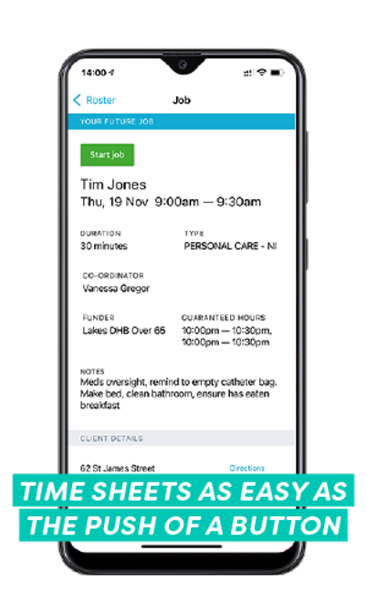
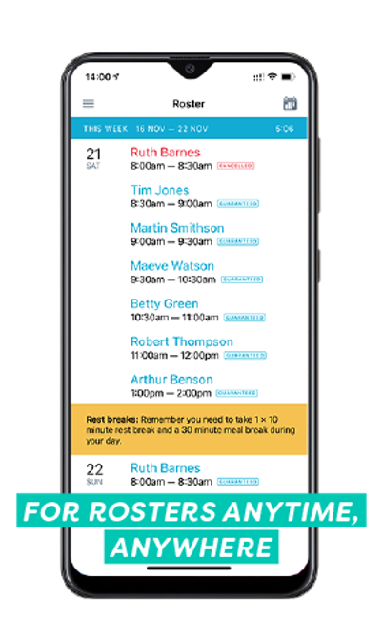
Communication inequality
HSWs always be accessible to providers but they lack access themselves
Diminished quantity and/or quality of communication with management proceeding introduction of apps
Little to no provision for interaction with colleagues
Tracking and surveillance functionality erode trust

Slide 16
Deborah: …as far as I’m concerned it's just got worse in fact you very seldom hear from them. It's difficult to get through to them, I mean […] the last few times of ringing payroll it just seems to go to voicemail, you ring you tell them what your problem is, expecting to hear back and the next thing you get an email telling you what they're doing about it, and what you have to do. And it's like well that’s real impersonal or you’ll ring the call centre ask them to do something, or you leave a message […] And it just doesn't happen. These are huge breakdowns in communication.
Notes:
Lisa

Slide 17
Health and safety
Significant risks to health and safety for caregivers exacerbated by COVID-19
General trends towards platformisation, with its associated rationalisation and cost-cutting further exacerbates these risks while not introducing wide-spread safety improvements
Call centre phone systems make getting support more difficult
Health and safety risks associated with phone use
Working in this under-resourced, demanding job is experienced as ‘emotionally and mentally battering’

Slide 18
Recommendations
Improve the systemic context surrounding platform technology in the home care sector
Salaried roles
Better resourcing
Strengthen accountability

Slide 19
Recommendations
Technologies being used within the home care centre must be explicitly human centred and demonstrably improve the quality and safety of home care
Include worker voice through development, implementation and evaluation
Uphold Te Tiriti o Waitangi

